Slide 1
GeoPose Overview
Steve Smyth, Editor
119th OGC Member Meeting
Virtual | 16th June 2021

Slide 2
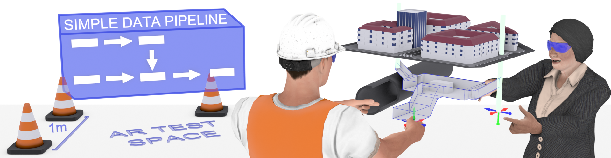
GeoPose Vision
Two or more arbitrary systems can exchange information about
the position and orientation of objects or linked assemblies of objects in a geographical framework, even if the systems use different local frames of reference.
Notes:
Jeremy: say in the vision that this has to do with geographical locations

Slide 3
What’s New
Basic-Euler became Basic-YPR [yaw, pitch, roll]
Basic-Quaternion disallows extra properties
Quaternion components got field names [x, y, z, w]
Recognised a new use case for video/mobile sensor synchronized GeoPose sequences
Imaging sensor pose sequence – e.g. relative to gimbal/camera frame
Environmental sensor pose sequence – e.g. relative to radiation sensor response geometry
Platform pose – relative to vehicle frame
Nadir – relative to local vertical
Nearest target – relative to up/ray to closest object
W3C WebVMT and sample data Schema + GeoPose validation and samples
Notes:
the GeoPose standard is under development and things may change before we are done.
Since all systems have their proprietary frameworks,
interoperability would only be achieved through
APIs or transforms between proprietary frameworks.

Slide 4
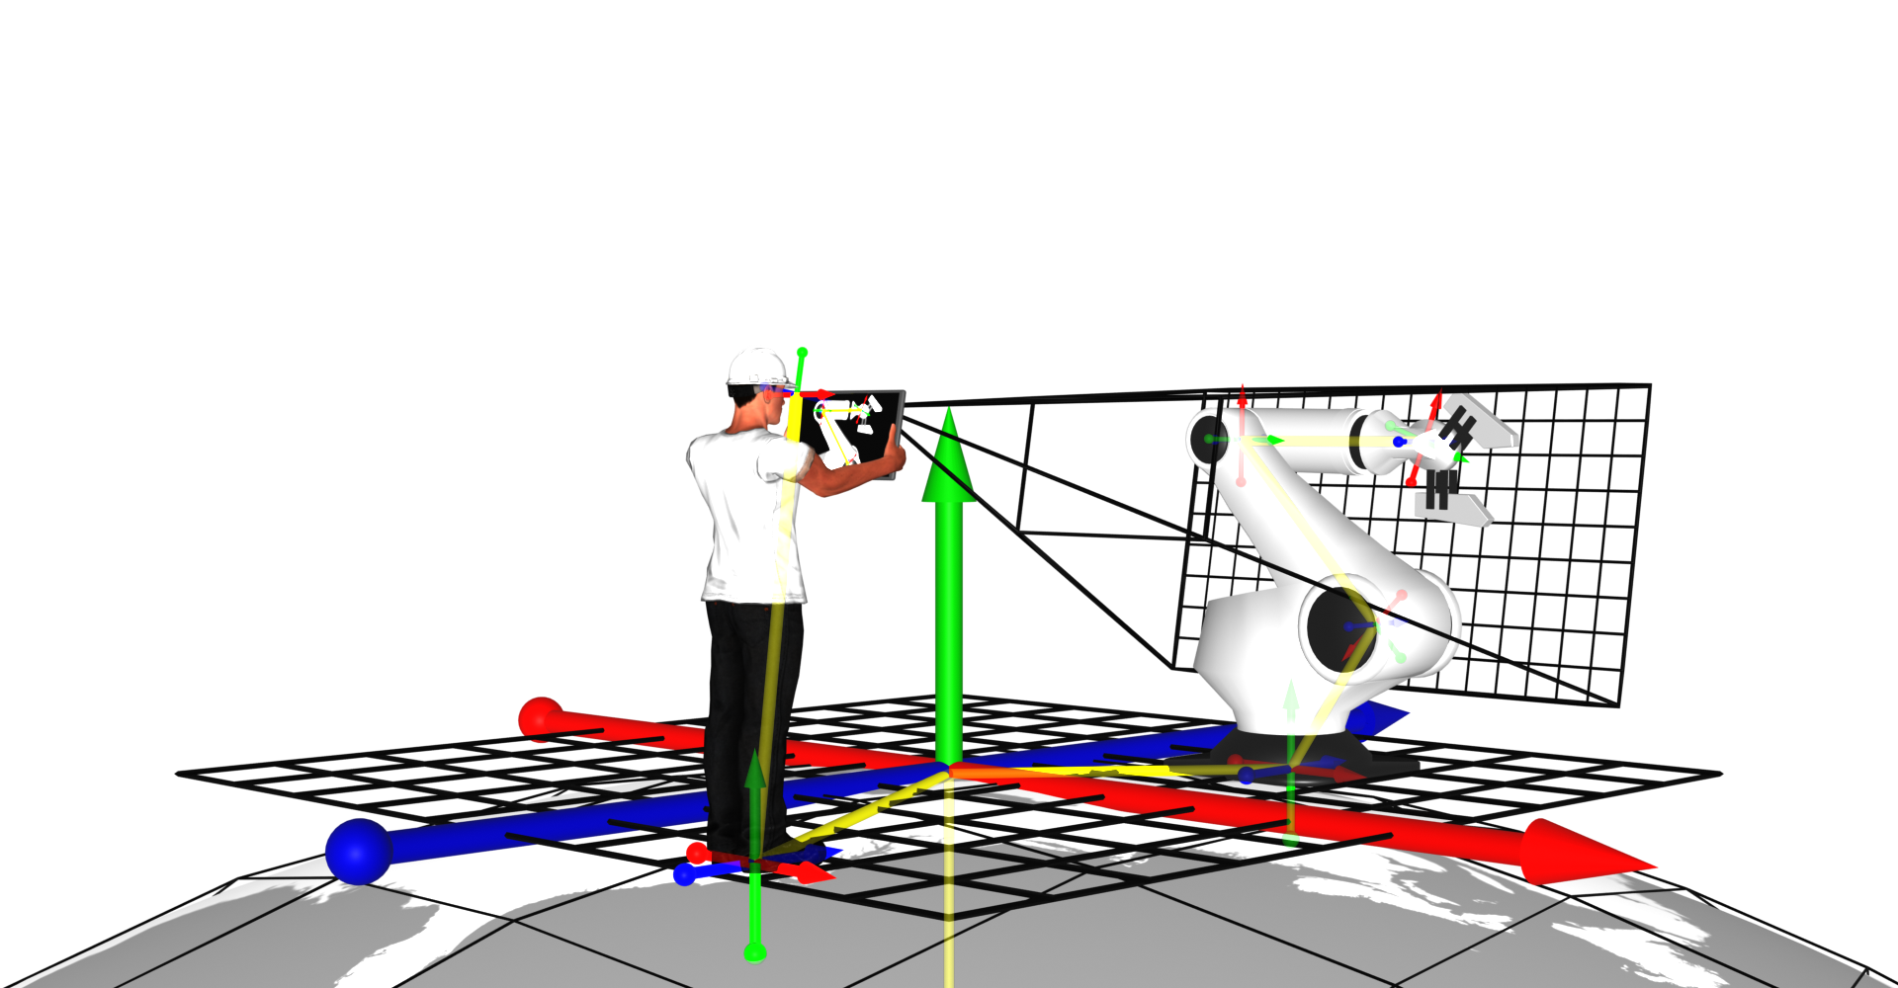
What is a Pose?
We are interested in two principal poses here: the tablet device with its AR view, and the manipulator on the robot arm. We have an outermost Cartesian frame for the site with a chain (in yellow) of sub-frames and associated transforms through the person and robot which link the two poses.
Notes:
Basic problem, relating viewers and objects - representing their positions and orientations in space. Often starts with relative positions

Slide 5
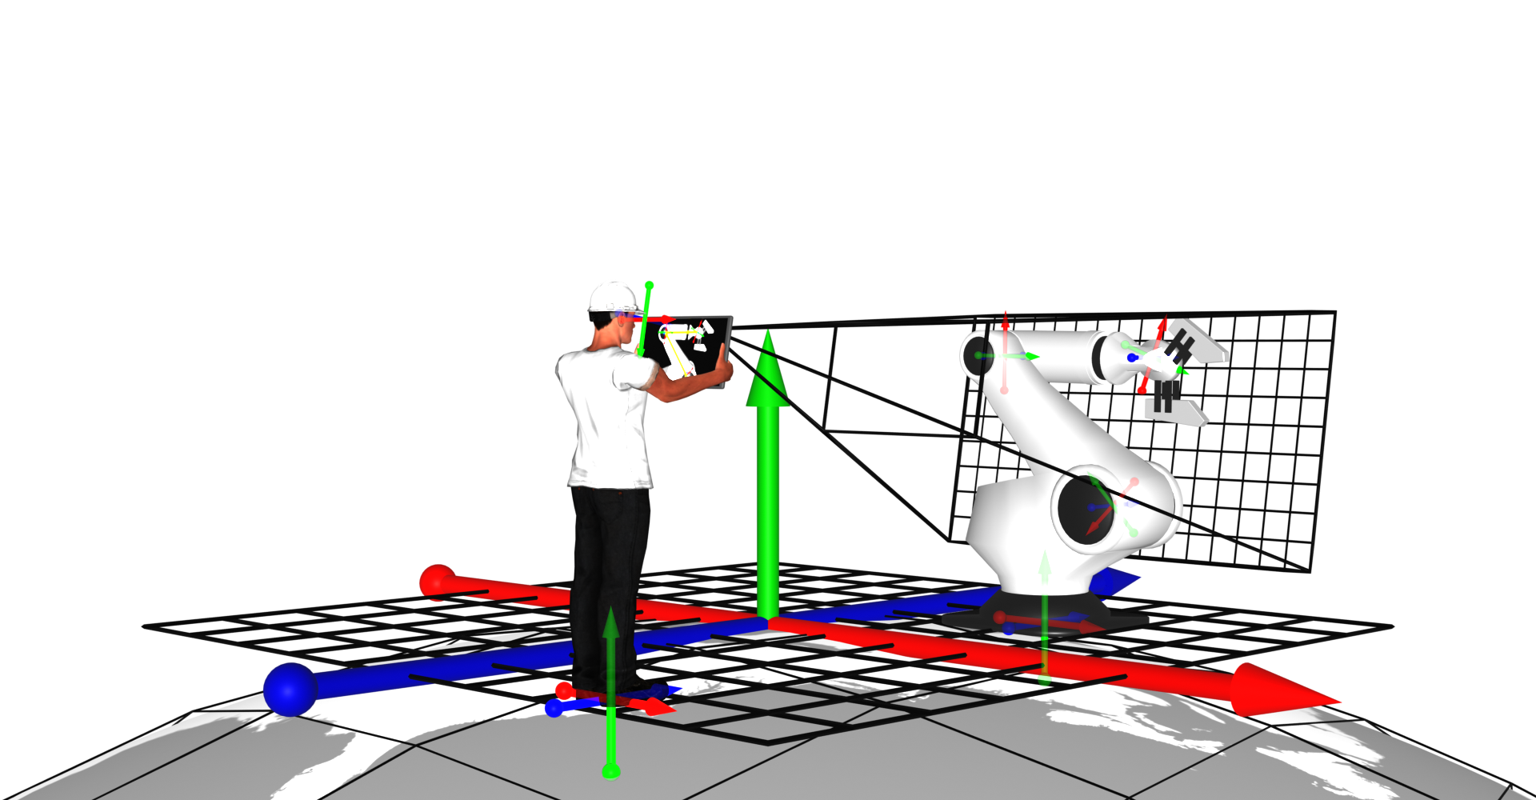
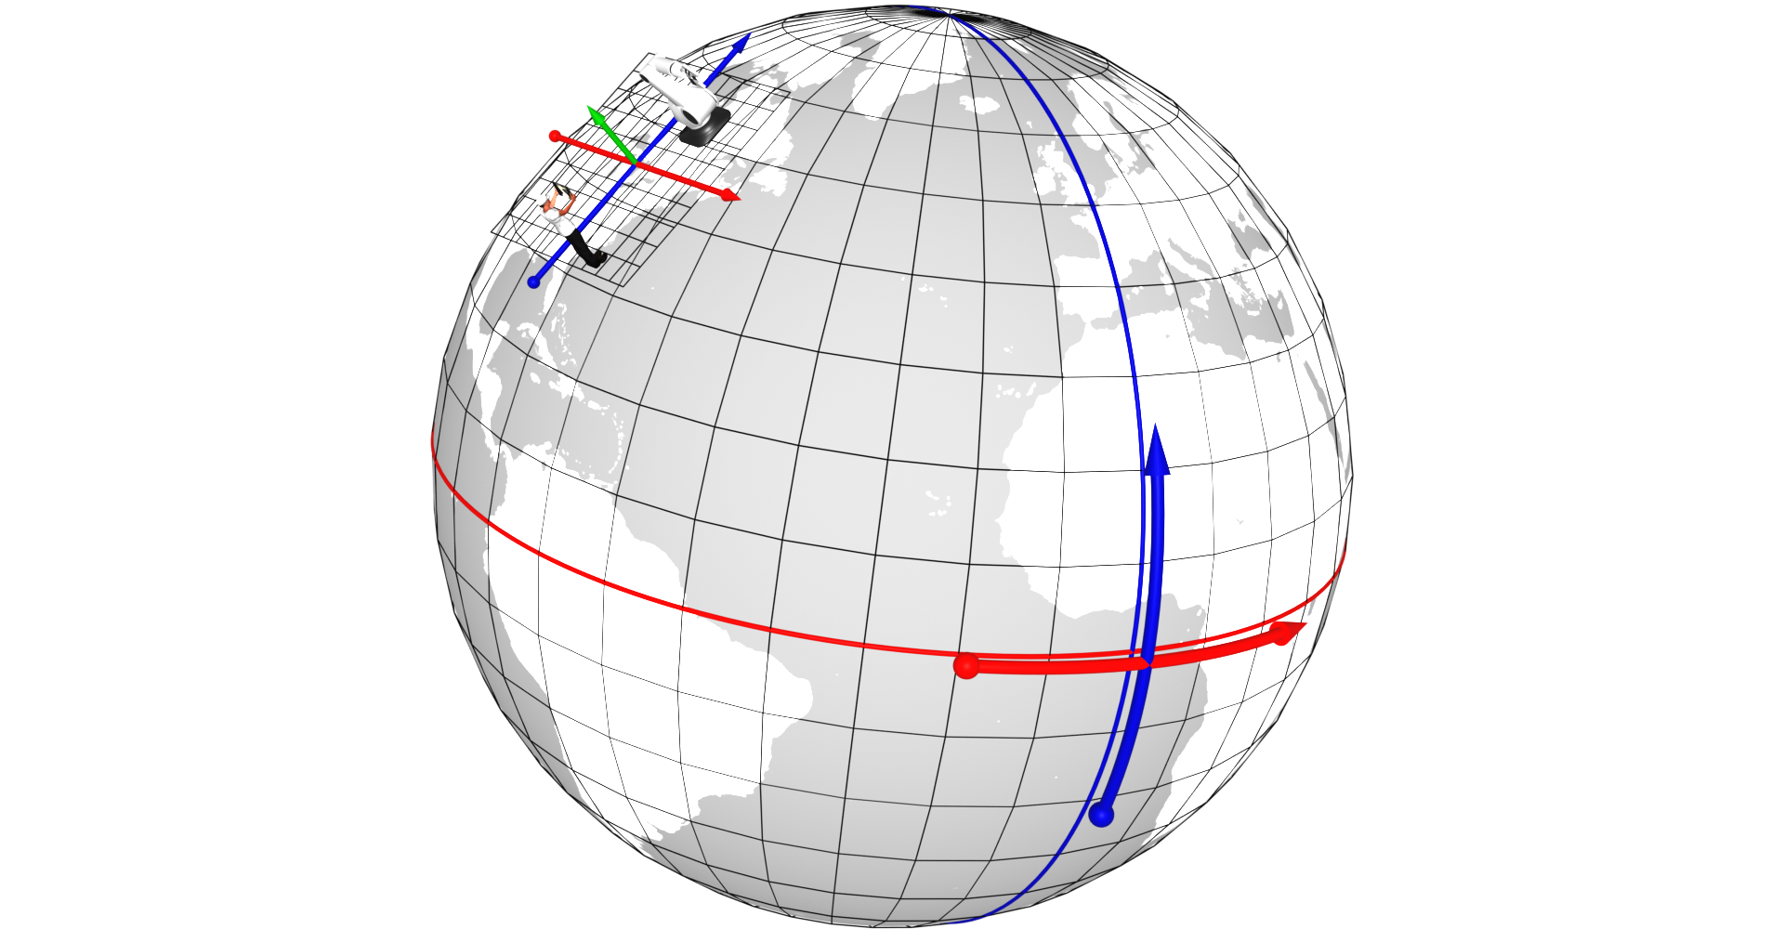
What is a GeoPose?
If a requirement is to relate the objects and their poses in the site Cartesian frame to other objects in the real world, e.g. from geospatial databases, or to link with other systems, we may extend a graph of linked frames (a chain, in the illustrated case) outwards to link our Cartesian local frame to a geospatial topocentric reference frame.
Notes:
But ultimately we need to relate these positions and orientations into a geographical or geospatial framework to be able to relate to fixed infrastructure, or objects represented in other computer systems

Slide 6
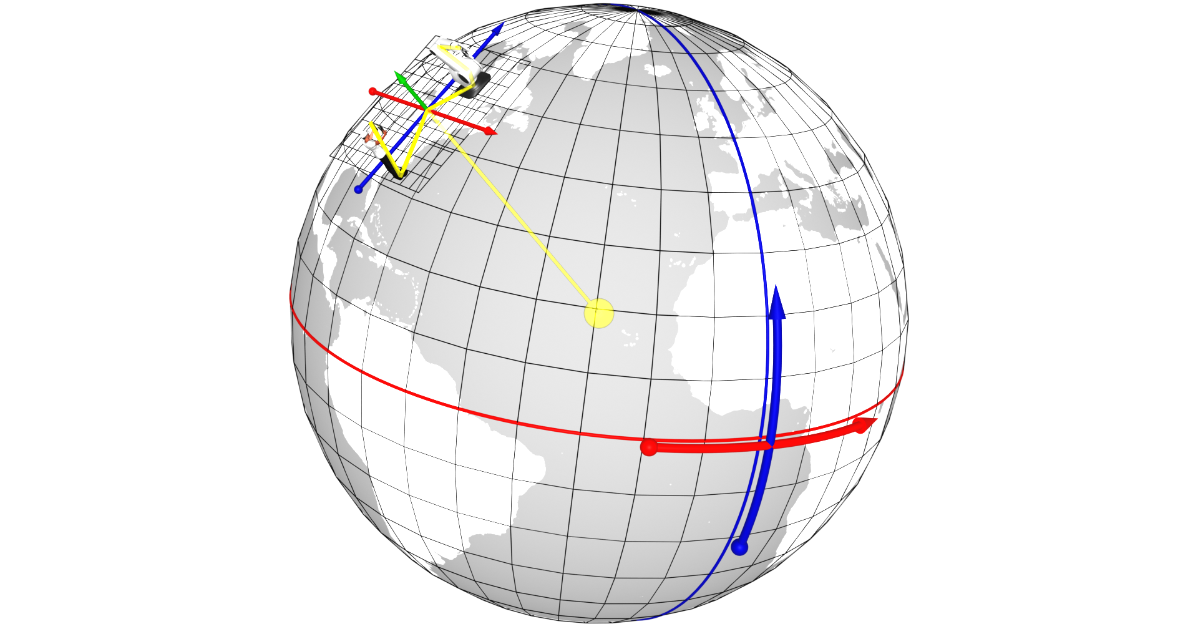
Conceptual Definition of GeoPose
A Pose captures location and orientation of a real or digital object.
A Pose has an associated FrameTransform Chain. The Pose’s FrameTransform Chain encapsulates sufficient information to transform pose geometry in any component Frame to any other Frame in its associated FrameTransform Chain.
A Fixed Pose is a Pose whose associated Outermost Frame is related to an Ephemeris Object - a spatial object whose location and orientation are externally defined.
A GeoPose is a Fixed Pose related to a geospatial Ephemeris Object (the Earth) via a Topocentric Reference Frame.
Short Version:
A GeoPose ties the location and orientation of a spatial object to the Earth’s surface.
Notes:
From this we derive the idea of poses, and the chained reference systems to relate between the geographical, Earth-based system and individual objects and their histories of locations and orientations

Slide 7
Summary
GeoPose is
GeoPose is not
an encapsulation of location and orientation as a concrete data object
based on a logical data model
with a JSON encoding to express, capture, save and share the position and orientation of any real or digital object and observer in the real world.
a method to obtain a person, place or thing’s earth-anchored position or pose,
a substitute for the camera sensor model,
an API or library

Slide 8
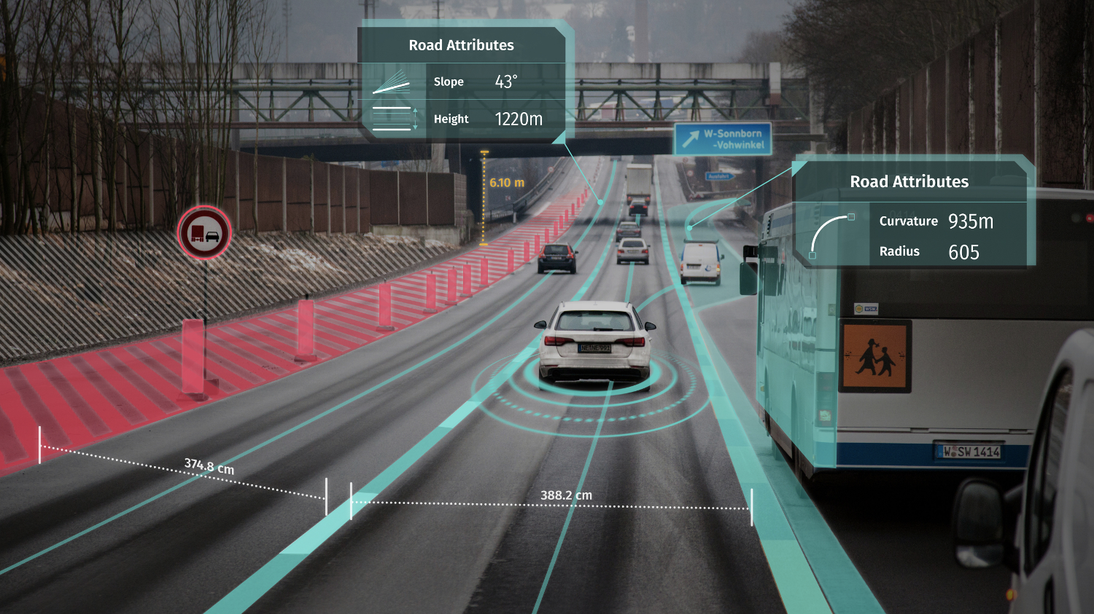
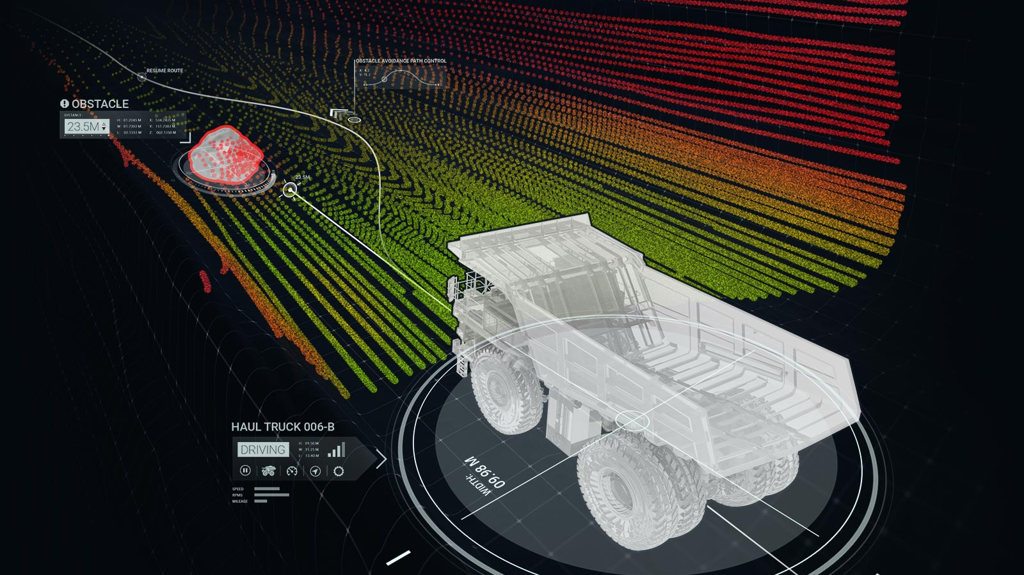
Autonomous Vehicles & Robots
Dynamic situational awareness with respect to other vehicles (cars, trucks, trains, bicycles), people, animals, and other objects (where they are moving independently in space and time)
GeoPose for guidance and to avoid
Timestamp allows for precise synchronization
https://www.geospatialworld.net/news/dubai-technologies-partner-support-self-driving-transportation-expo-2020/

Slide 9
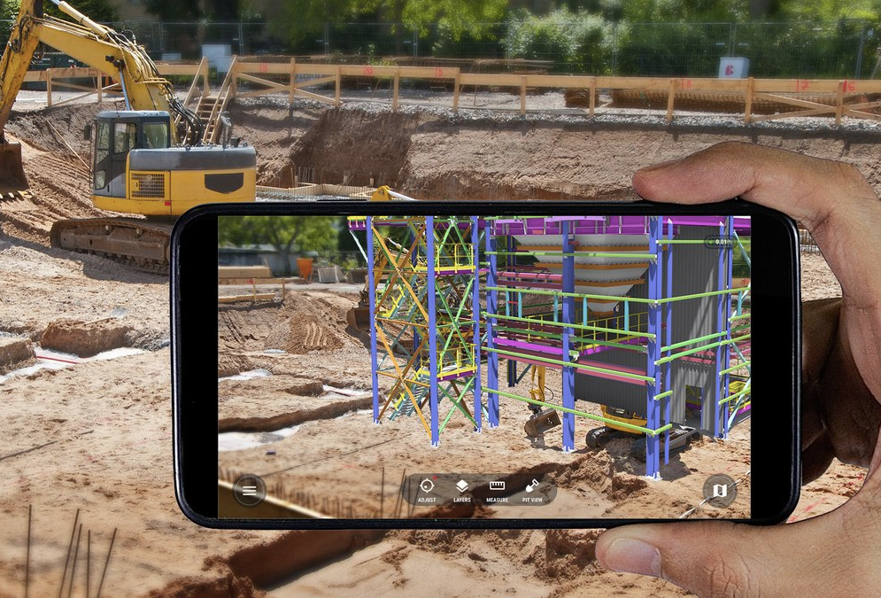
Long-term Persistent Objects
Use case involving primarily stationary 3D objects (synthetic or real) anchored to the surface of the earth, GeoPose express how buildings or other elements of the built environment (e.g., Manufacturing, Architecture, Construction, Engineering) are positioned and oriented in a shared geospatial frame of reference.
https://pbs.twimg.com/media/EOIzH7yX4AEHVGT.jpg
Notes:
Shared frame of reference is the deepest/basic concept
Does GeoPose pertain to any real world or synthetic object? Yes all moving and stationary objects, people, things have GeoPose. (covered moving objects in two previous slieds)
Making a distinction between absolute and relative pose.
Absolute
Relative is part of using GeoPose. Not captured within GeoPose
Orientation is expressed as part of GeoPose relative to each axes
Instead of having zones, with abrupt changes between zones, each item (wherever it is) cab always been given/obtain a GeoPose.
Depends on where you consider the origin to be.

Slide 10
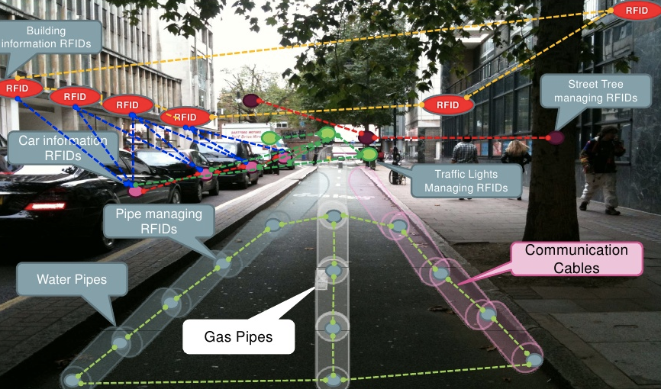
GeoSpatially-anchored Augmented Reality
Overlay of synthetic objects on the real world
That is persistent
Multi-user access (same objects can be seen by multiple users in real time)
Device GeoPose with respect to the real world, other users and the synthetic object
https://image.slidesharecdn.com/augmentedrealitygisvisualisation-100326064446-phpapp01/95/augmented-reality-a-new-geovisualisation-method-for-gis-20-728.jpg?cb=1269586955

Slide 11
Requirements GeoPose Addresses for these Use Cases
Achieves interoperability across
Services
Products
Industries
Provides agreement on
Semantics and naming
What is meant by height/elevation?
Data Types, Encodings, Syntax
Order of coordinates
Units
Frames of Reference
Definition of origin
One system can interpret FOR from another
https://www.aerotime.aero/aviation-blog/wp-content/uploads/2016/06/2000px-Vertical_distances.svg.png

Slide 12
GeoPose Standardisation Targets 1/2
Standardisation targets are data objects
Targets support Use Cases
Targets are the core normative part of the specification
Implementors need only implement individual targets
Specification of the targets: Structure + Encoding
Structure
The structure of the standardisation targets is (mostly) encoding-neutral.
Structural elements are aliased components of the UML logical model.
Applicable to multiple encodings.
Encoding
We chose JSON for the first encoding
It is webby.
It is widely used.
JSON-Schema allows automated testing and implementation.
Binary encodings may follow.
Notes:
PLEASE quickly define what an implementation target is!

Slide 13
GeoPose Standardisation Targets 2/2
The Basic GeoPose targets are simple and concise – no options. It satisfies most use case requirements.
The Advanced GeoPose target supports more complex use cases where the outer geographic reference frame is not LTP-ENU and/or a valid time is needed.
Composite:
The Chain GeoPose target provides additional flexibility with multiple intermediate frames or specific coordinate reference systems as needed.
The Frame Graph target supports the full structure need to represent networks of reference frames that arise with the use of multiple and linked location technologies.
The (Time) Sequence targets support the packaging of fixed-length time series of GeoPoses and the payload data objects for open-ended GeoPose streams from an external source.

Slide 14
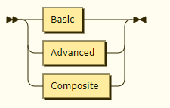
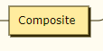
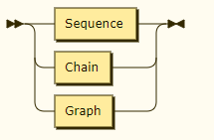
Eight Independent GeoPose Targets
Basic – Simple but widely applicable
Fixed outer reference frame – LTP-ENU
Yaw, pitch, and roll angular orientation [1]
Quaternion orientation [2]
Advanced – For more complex applications [3]
Choice of reference frames
Timestamp
Composite
(Time) Sequence
(Time) Series [regular: 4, irregular: 5]
Streams [6]
Chain – directed, non-branching linked transformations [7]
Graph – directed linked transformations representing multiple pose relationships in an environment [8]
GeoPose Implementation Targets
Composite
Sub-targets

Slide 15
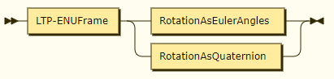
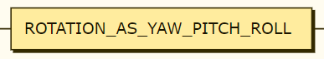
Basic
A Basic GeoPose consists of a single Frame Transform: from a local tangent plane coordinate system anchored to a point, identified by WGS-84 geographic coordinates and a height above the WGS-84 ellipsoid, to a rotated Cartesian coordinate system.
Rotation may be specified as a set of yaw, pitch, and roll angles in degrees or as a quaternion: there are two corresponding implementation targets: Basic-YPR and Basic-Quaternion.
Basic GeoPose
LocalTangentPlane-ENU-Frame
Oriented to the North

Slide 16
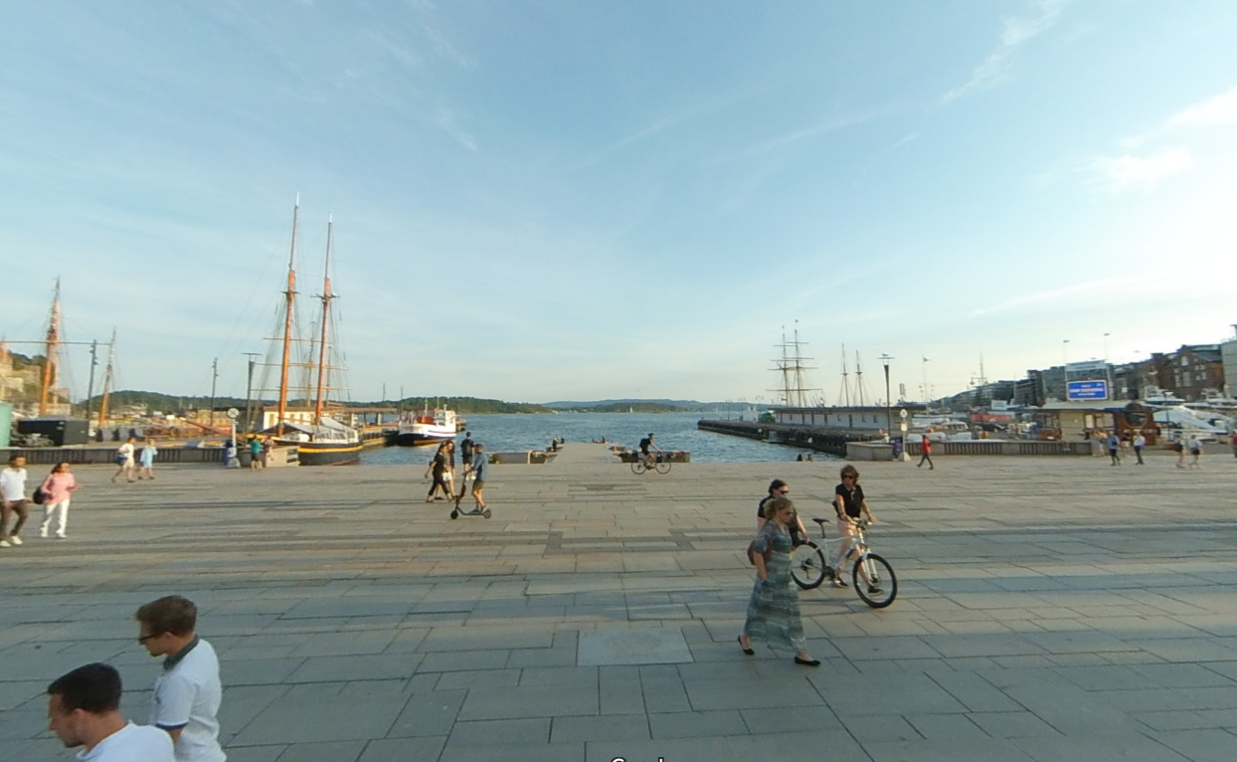
Encoded Example: Basic-Quaternion
{
"longitude": 10.73296,
"latitude": 59.91119,
"height": 41.4,
"quaternion": {"x": 0.0, "y": 0.0, "z": 0.98, "w": 0.2}
}

Slide 17
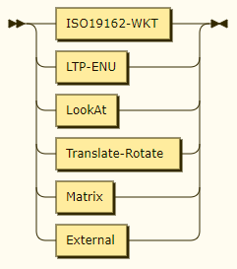
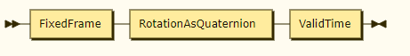
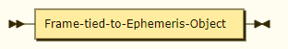
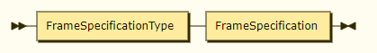
Advanced
The Advanced target allows specification of a range of outer reference frames
Rotation is specified as a quaternion
An optional valid-time instant value may be attached
Advanced
Fixed frame
Frame Specification Types
Frame

Slide 18
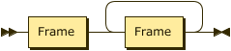
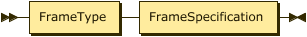
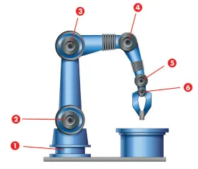
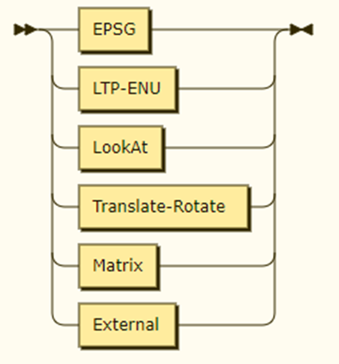

Composite: Chain
Chain
Frame
Notes:
A Chain consists of a linked list of at least two (Reference) Frames. Each pair of linked Frames defines a Frame Transform.
The first Frame in a linked pair is called the Outer Frame. The second Frame is called the Inner Frame.
Each Frame Transform maps coordinates in its Outer Frame to its Inner Frame.
The first Outer Frame is the Outermost Frame. The last Inner Frame is the Innermost Frame.
A Chain has a composite Frame Transform, mapping from the Outermost Frame to the Innermost Frame by sequentially applying all of the Frame Transforms in the chain.
A Chain functionally defines a single GeoPose.

Slide 19
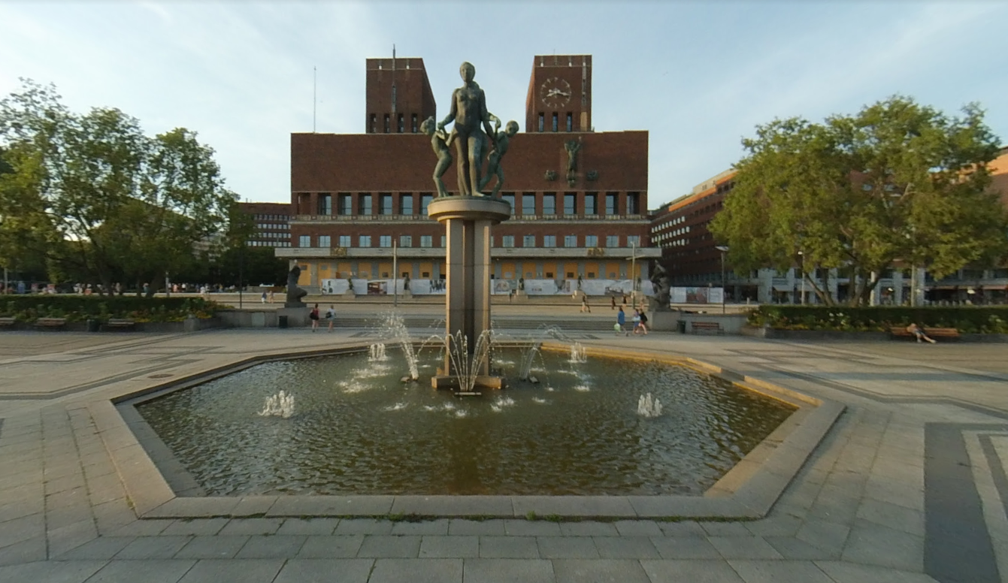
Example: Chain
{
"frames": [ {
"frameSpec": "LTP-ENUSpec",
"longitude": 10.73296,
"latitude": 59.91119,
"height": 0.0
}, {
"frameSpec": "Translate-RotateSpec",
"translation": [ 0.0, 0.0, 41.4 ],
"rotation": [ 1, 0, 0, 0 ]
}, {
"frameSpec": "TranslateRotateSpec",
"translation": [ 0.0, 0.0, 0.0 ],
"rotation": [ 0, 0, 0, 1]
}
]
}

Slide 20
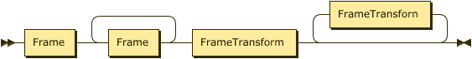
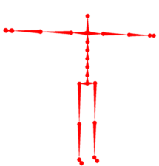
Composite: (Frame) Graph
A Frame Graph is a directed acyclic graph with Frame Transforms as edges and Frames as vertices. It is a more general structure for representing the transformational relationships among linked Frames.
There are at least two Frames and one FrameTransform in a FrameGraph.
Any path in a Frame Graph defines a Chain (Pose).
A Basic GeoPose has two frames and one Frame Transform.
FrameGraph

Slide 21
Composite: Graph
{
"frames": [ {
"frameSpec": "LTP-ENUSpec",
"longitude": 10.73296,
"latitude": 59.91119,
"height": 0.0
}, {
"frameSpec": "Translate-RotateSpec",
"translation": [ 0.0, 0.0, 41.4 ],
"rotation": [ 1, 0, 0, 0 ]
}, {
"frameSpec": "TranslateRotateSpec",
"translation": [ 0.0, 0.0, 0.0 ],
"rotation": [ 0, 0, 0, 1]
},
“frameTransforms”: [
[[0, 1], [1, 2]]
}

Slide 22
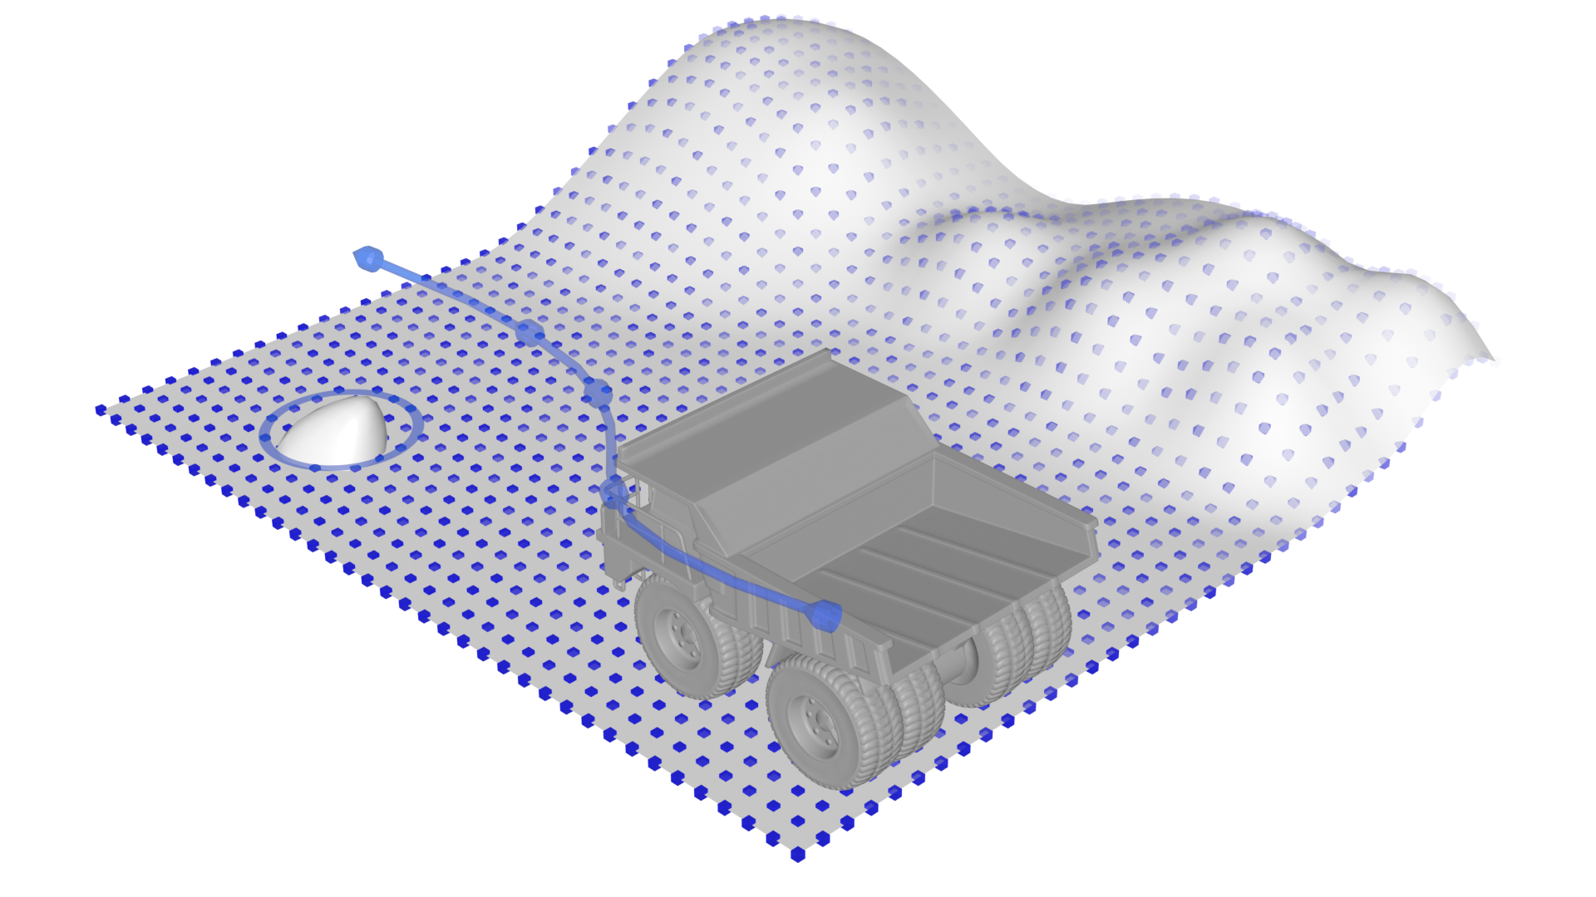
Composite: Sequence
A GeoPose Sequence is a time series of GeoPoses.
The Series is a packaged time series of GeoPoses with fixed or variable time separation.
The number of GeoPoses is fixed.
A Regular series has constant time separation .
An Irregular series has an explicit valid time associated with each GeoPose.
The Stream is an open-ended time series of GeoPoses delivered by an external source.
The number of GeoPoses in a stream is not known.
There is an explicit valid time associated with each GeoPose in a stream.
The GeoPose specification only defines the data objects to be transported in a Stream.
The transport is responsible for delivering the content.
The transport is responsible for ensuring the integrity of the content.
The transport defines the API.

Slide 23
Current Status of GeoPose
GeoPose draft specification is now on GitHub and we welcome your feedback
https://github.com/opengeospatial/GeoPose

Slide 24
What’s New
Basic-Euler became Basic-YPR [yaw, pitch, roll]
Basic-Quaternion disallows extra properties
Quaternion components got field names [x, y, z, w]
Recognised a new use case for video/mobile sensor synchronized GeoPose sequences
Imaging sensor pose sequence – e.g. relative to gimbal/camera frame
Environmental sensor pose sequence – e.g. relative to radiation sensor response geometry
Platform pose – relative to vehicle frame
Nadir – relative to local vertical
Nearest target – relative to up/ray to closest object
W3C WebVMT and sample data Schema + GeoPose validation and samples
Notes:
the GeoPose standard is under development and things may change before we are done.
Since all systems have their proprietary frameworks,
interoperability would only be achieved through
APIs or transforms between proprietary frameworks.

Slide 25
Questions?

